Slide 1
Predictive Modeling of Diabetes Using CHAID Decision Trees in SPSS Modeler Using IBM SPSS Modeler
Presentation
Presented by: Somen Mandal
Rahul Kar Modak
Harsh Kr Singh

Slide 2
Project Brief
This project focuses on predicting whether a person is diabetic based on medical features.
Using Machine Learning models, the dataset is analyzed to uncover patterns that influence diabetes.
The project demonstrates practical applications of classification techniques using real-world health data.

Slide 3
Introduction
Diabetes is one of the most rapidly increasing health problems globally.
Early prediction can reduce complications and help patients take preventive steps.
This project uses machine learning to:
Analyze key medical indicators
Predict diabetes likelihood
Identify important health features

Slide 4
Feasibility Study
Technical
• Implemented using Python (Pandas, NumPy, Scikit-Learn, Matplotlib).
• Dataset is structured and easy to process.
Operational
• Suitable for healthcare predictive analytics.
Economic
• Uses free datasets and open-source libraries.
Time Feasibility
• The complete process can be completed within 1–2 weeks
…

Slide 5
Dataset Details
Dataset Name: diabetes_large.csv
Rows: 35,000
Columns: 9
Features Included:
  Pregnancies
  Glucose
  Blood Pressure
  Skin Thickness
  Insulin
  BMI
  Diabetes Pedigree Function
  Age
  Outcome (Target)
Description:
This dataset contains medical diagnostic measurements used to predict whether a patient is likely to have diabetes (Outcome = 1) or not (Outcome = 0). The features represent important clinical parameters such as glucose level, BMI, insulin level, age, and more. These variables are commonly used in healthcare analytics for early detection of diabetes.

Slide 6
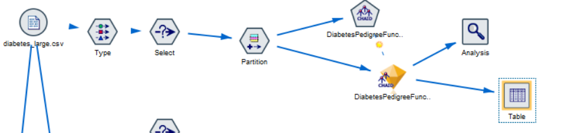
CHAID Model 1: Diabetes Prediction
Objective: Predict diabetic vs non-diabetic
Inputs: Glucose, BMI, Age, etc.
Model: CHAID Decision Tree
Insights: Glucose strongest factor, BMI & Age significant
Outcome: Clear rules for classification

Slide 7
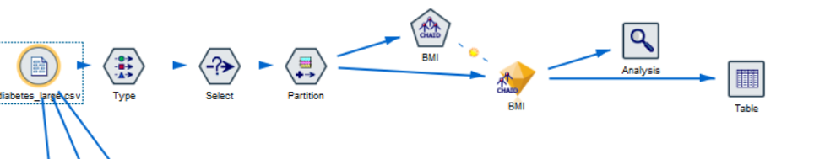
CHAID Model 2: BMI Category Prediction
Objective: Predict BMI class (Underweight–Obese)
Inputs: Age, Glucose, Skin Thickness
Insights: Age major split; Glucose helps identify overweight/obese
Outcome: Good segmentation for health monitoring

Slide 8
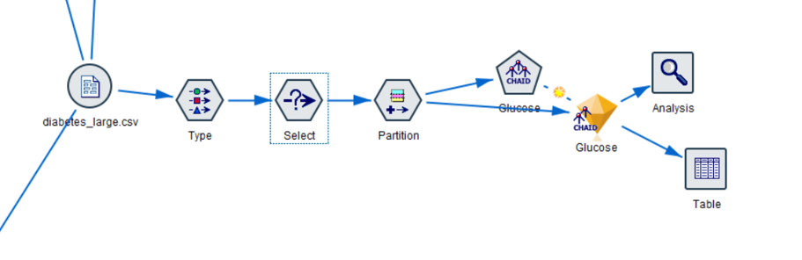
CHAID Model 3: Glucose Level Category Prediction
Objective: Categorize glucose (Low/Normal/High/Very High)
Inputs: BMI, Insulin, Age
Insights: BMI + Insulin strongly affect glucose category
Outcome: Helps identify early diabetes risk groups

Slide 9
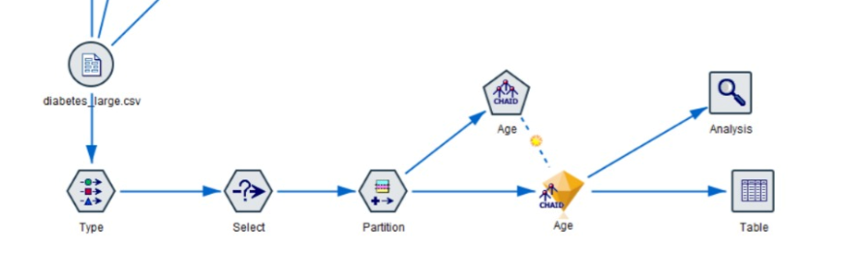
CHAID Model 4: Age Group Prediction
Objective: Predict age clusters (Youth, Adult, Middle-Aged, Senior)
Inputs: Glucose, BMI, Pregnancies, Insulin
Insights: BMI/Glucose split age ranges well
Outcome: Useful for demographic segmentation

Slide 10
Feasibility Study
Technical Feasibility
The dataset contains structured medical attributes (Glucose, BMI, Age, Insulin, Blood Pressure), making it ideal for CHAID decision tree modeling.
Tools such as Python, SPSS Modeler, and Scikit-Learn efficiently support data preprocessing, visualization, and CHAID-based classification.
The models are interpretable, rule-based, and easy to integrate into healthcare decision systems.
Operational Feasibility
Healthcare professionals can easily understand CHAID-generated rules for diagnosis.
No complex infrastructure is required—runs smoothly on a standard laptop.
Useful for hospitals, clinics, and screening camps to classify patients quickly.
Economic Feasibility
The dataset is publicly available and free.
Tools used are open-source or educational versions, reducing cost.
CHAID models have low computational cost, making them ideal for large-scale medical use.
Time Feasibility
Entire project—data cleaning, EDA, modeling, and evaluation—can be completed within 1–2 weeks.
CHAID models are fast to train and produce results quickly, even with large datasets.

Slide 11
Overall Model Findings
Key Observations Across All 4 CHAID Models
Glucose, BMI, and Age consistently emerged as the most influential factors across multiple predictions.
CHAID’s multi-level splitting created clear, interpretable rules, making it suitable for medical professionals who need transparent decision logic.
Model-Specific Highlights
Model 1 (Diabetes Prediction):
Glucose had the highest impact; BMI + Age combined strengthened prediction accuracy.
Model 2 (BMI Category Prediction):
Age played a major role in classifying BMI ranges; glucose and skin thickness added refinement.
Model 3 (Glucose Level Category):
Insulin levels, BMI, and Age created distinct glucose risk groups (Normal → Very High).
Model 4 (Age Group Prediction):
Pregnancies, BMI, and glucose effectively segmented Youth, Adult, Middle-Aged, and Senior groups.
Overall Insight
These CHAID models help in understanding health patterns, risk clusters, and patient profiles—providing actionable insights for early diagnosis and healthcare planning.

Slide 12
Conclusion
Key Takeaways
The diabetes dataset was successfully analyzed using CHAID Decision Tree Models, offering strong interpretability and clear decision pathways.
Glucose, BMI, Age, and Insulin repeatedly showed strong influence, proving their importance in diabetes-related assessments.
Model Effectiveness
CHAID produced easy-to-read decision flows, making predictions transparent for doctors and health workers.
Multi-class predictions (BMI, Age Group, Glucose Category) were handled efficiently with meaningful splits.
Healthcare Value
These models can support early risk detection, patient segmentation, and personalized health planning.
Insights can be used for awareness programs, screening camps, hospital OPDs, and telemedicine applications.
Final Conclusion
This project demonstrates that CHAID models are powerful tools for medical analytics—offering accuracy, simplicity, and actionable insights that can assist in improving patient care and preventive health strategies.

Slide 13
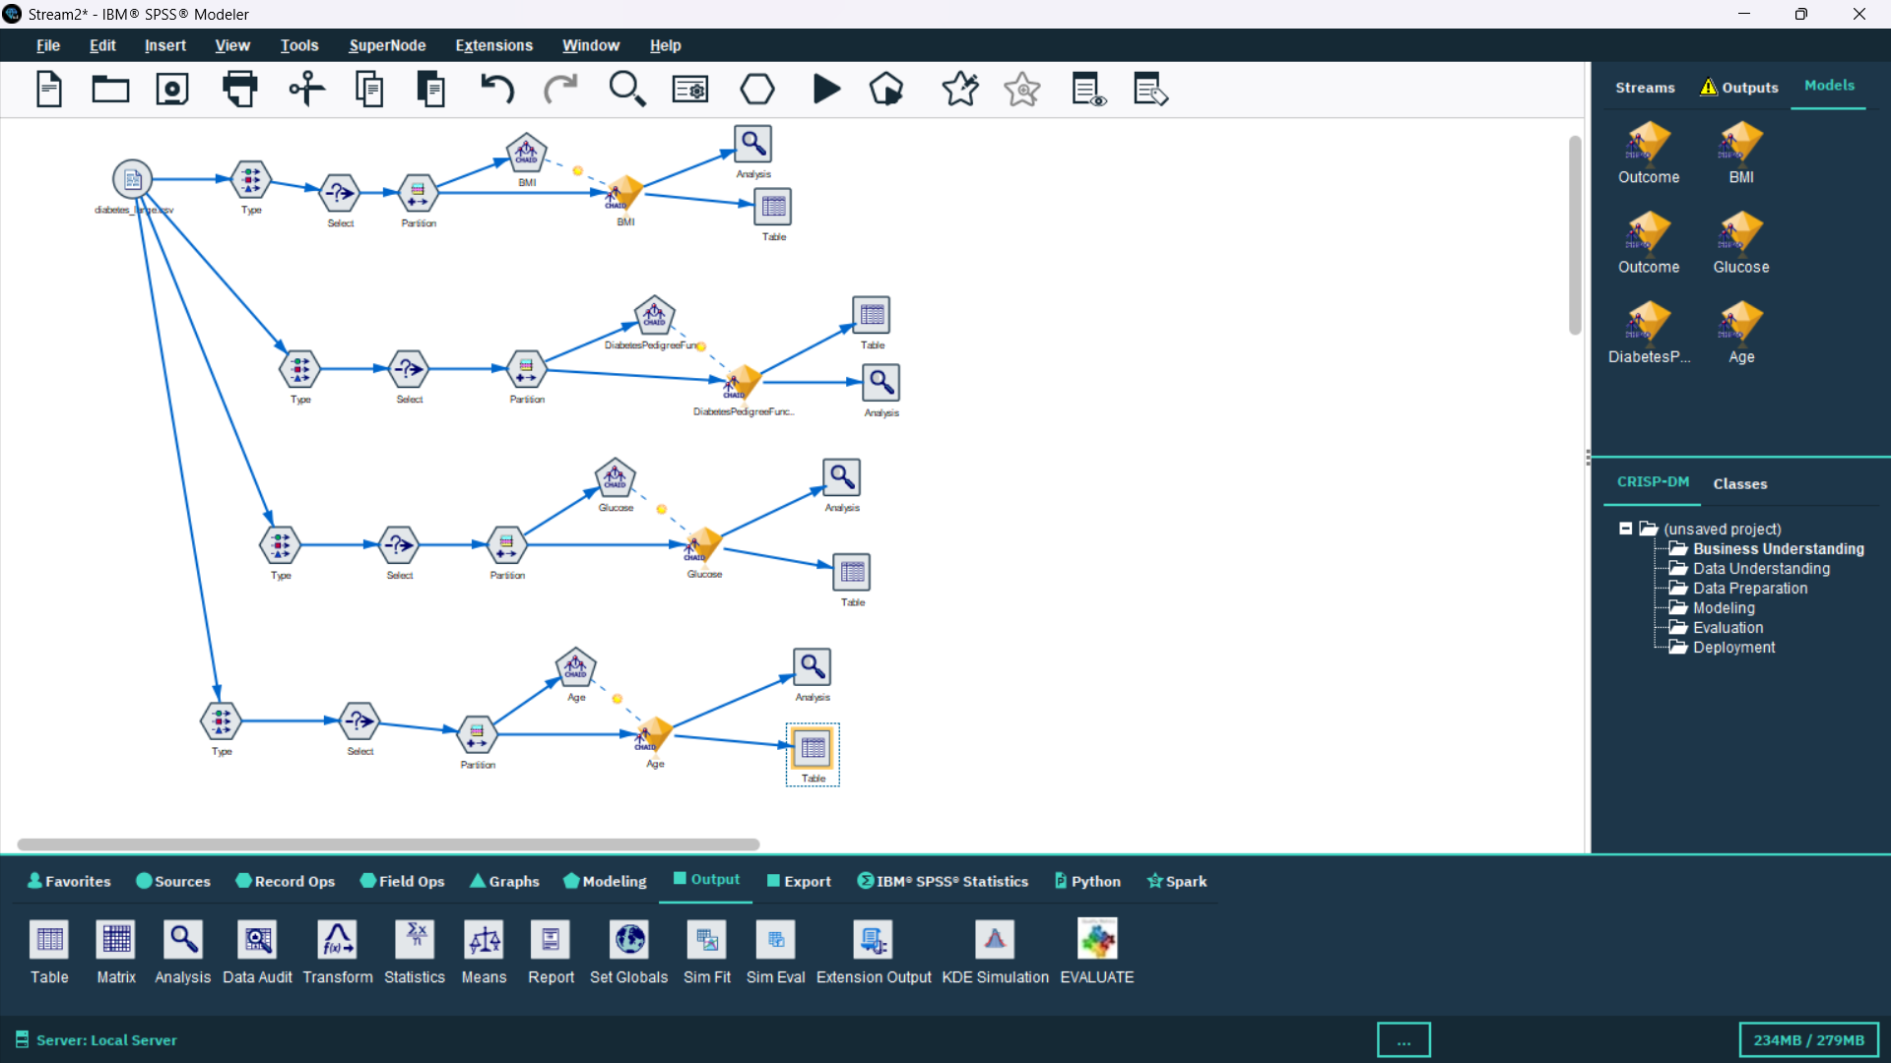

Slide 14
THANK YOU

